Slide 1
Dev Fest Weekend
October 12 2018
Dallas TX

Slide 2



Be Sure to thank our sponsors:

Slide 3
Get insights from data with Cognitive Services
Shawn Weisfeld
Cloud Solution Architect
Microsoft

Slide 4

About Me
Shawn Weisfeld
Cloud Solution Architect
Microsoft – One Commercial Partner Technical Team
sweisfel@microsoft.com
Austin, TX

Slide 5
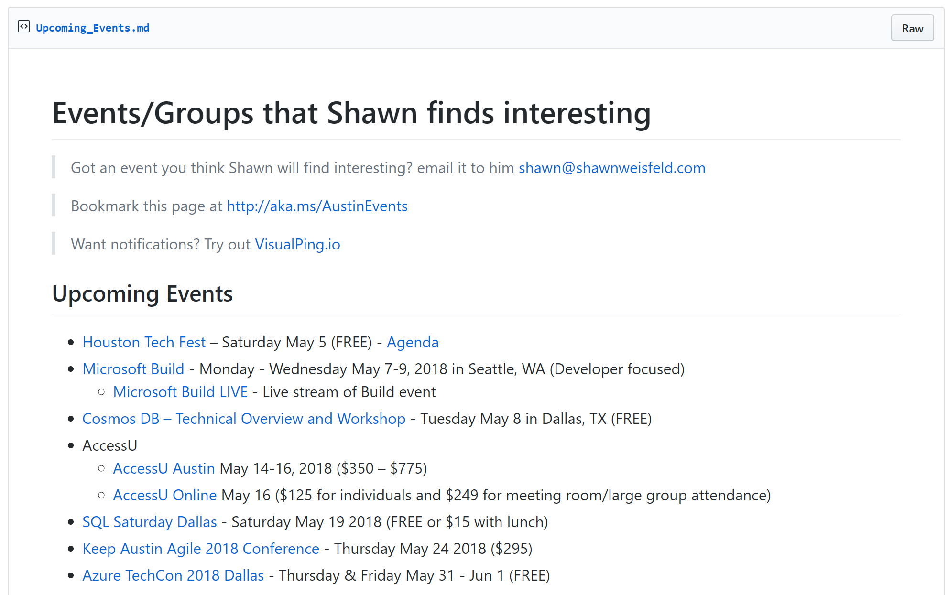
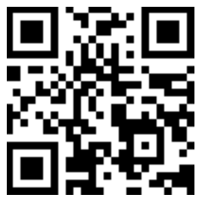
Regional Events
https://aka.ms/TOLAEvents

Slide 6


Watch User Group presentations for FREE online! We now have over 800 presentations online
Miss a User Group meeting?
Forget something that you learned?
Want to see content from a User Group not in your area?
Want to share with a buddy?
Presentations from the thought leaders on the topics you care about including:
Agile
Azure
C#
Entity Framework
HTML5
MVC
SQL
jQuery
and Much More!
We know you cannot make it to every session,
that is why we post them online for you!
New Content added all the time!
For new content announcements
@UserGroupTV
http://www.UserGroup.tv

Slide 7
Comprehensive deep learning,
machine learning as a service
Productive
Hybrid
Customizable services
VS, ML STUB, Tensor, Caffe
Tools
Bots, Cognitive, ML
Infrastructure and compute
CPU, GPU, FPGA
Intelligent
Azure
Trusted

Slide 8
What are Cognitive Services?

Slide 9
Cognitive Services Directory
https://azure.microsoft.com/en-us/services/cognitive-services/directory/

Slide 10
Demos!

Slide 11
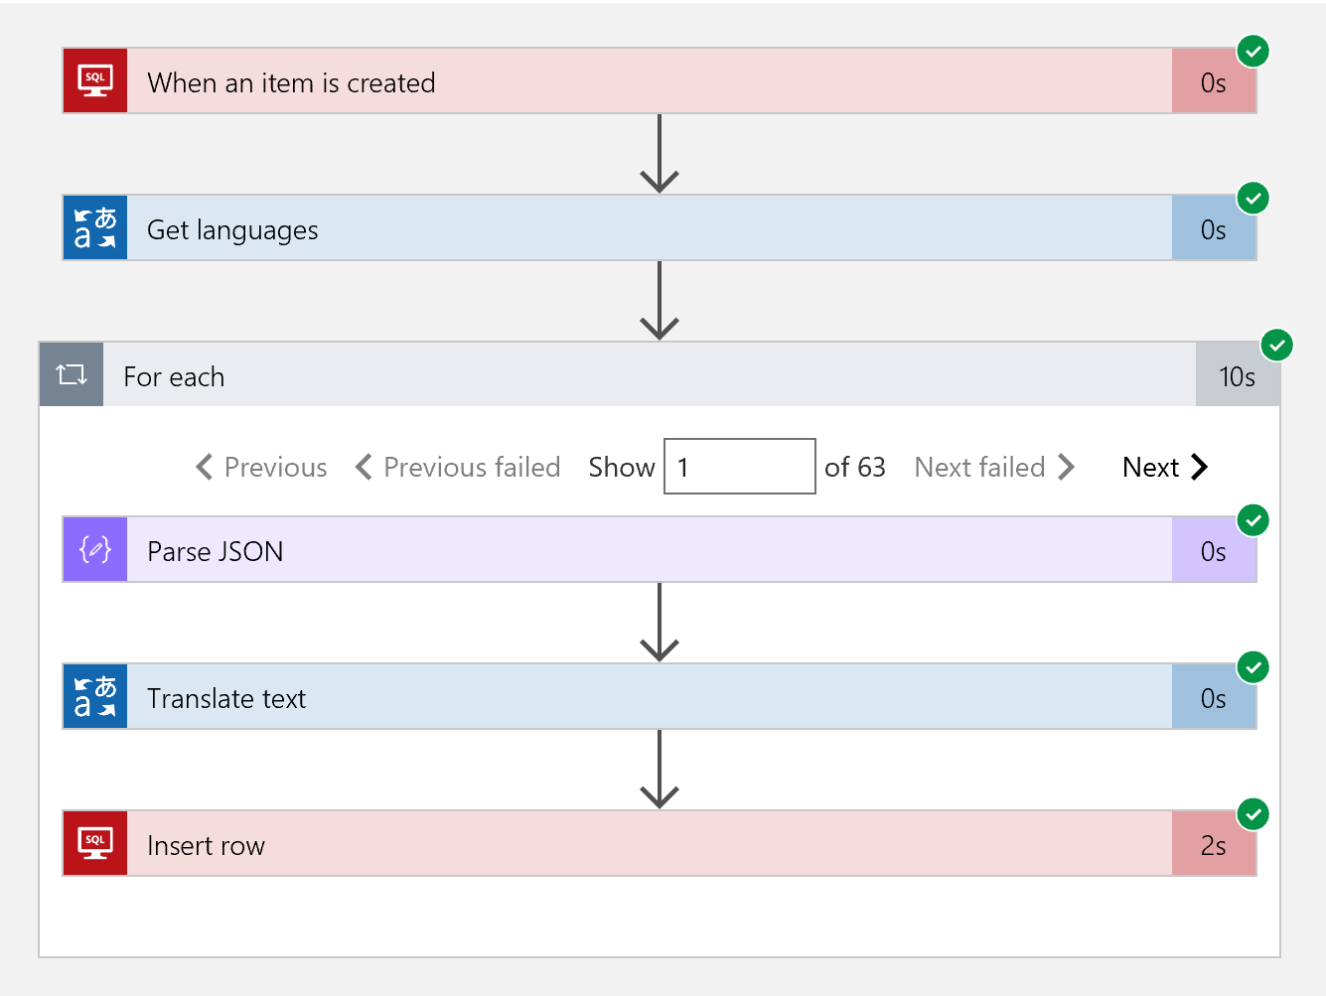
SQL Translator Demo
When a new record shows up in SQL Server translate it
SQL Azure DB
Logic App
Translation Cognitive Service

Slide 12
Car ID Demo - Custom Vision Service
Identify if a picture of a car is a sedan or an SUV
https://www.customvision.ai/

Slide 13
Video Indexer Demo
Enrich videos with meta data including, transcription, translation, people, brands, sentiment analysis, keywords, labels
https://vi.microsoft.com

Slide 14
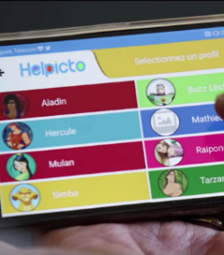
Helpicto
What if you could help a child with Autism communicate
https://microsoft.github.io/techcasestudies/cognitive%20services/2017/08/04/equadexcognitives.html

Slide 15

http://aka.ms/jfkfiles
T H E JFK F I L E S
The truth is in there

Slide 16
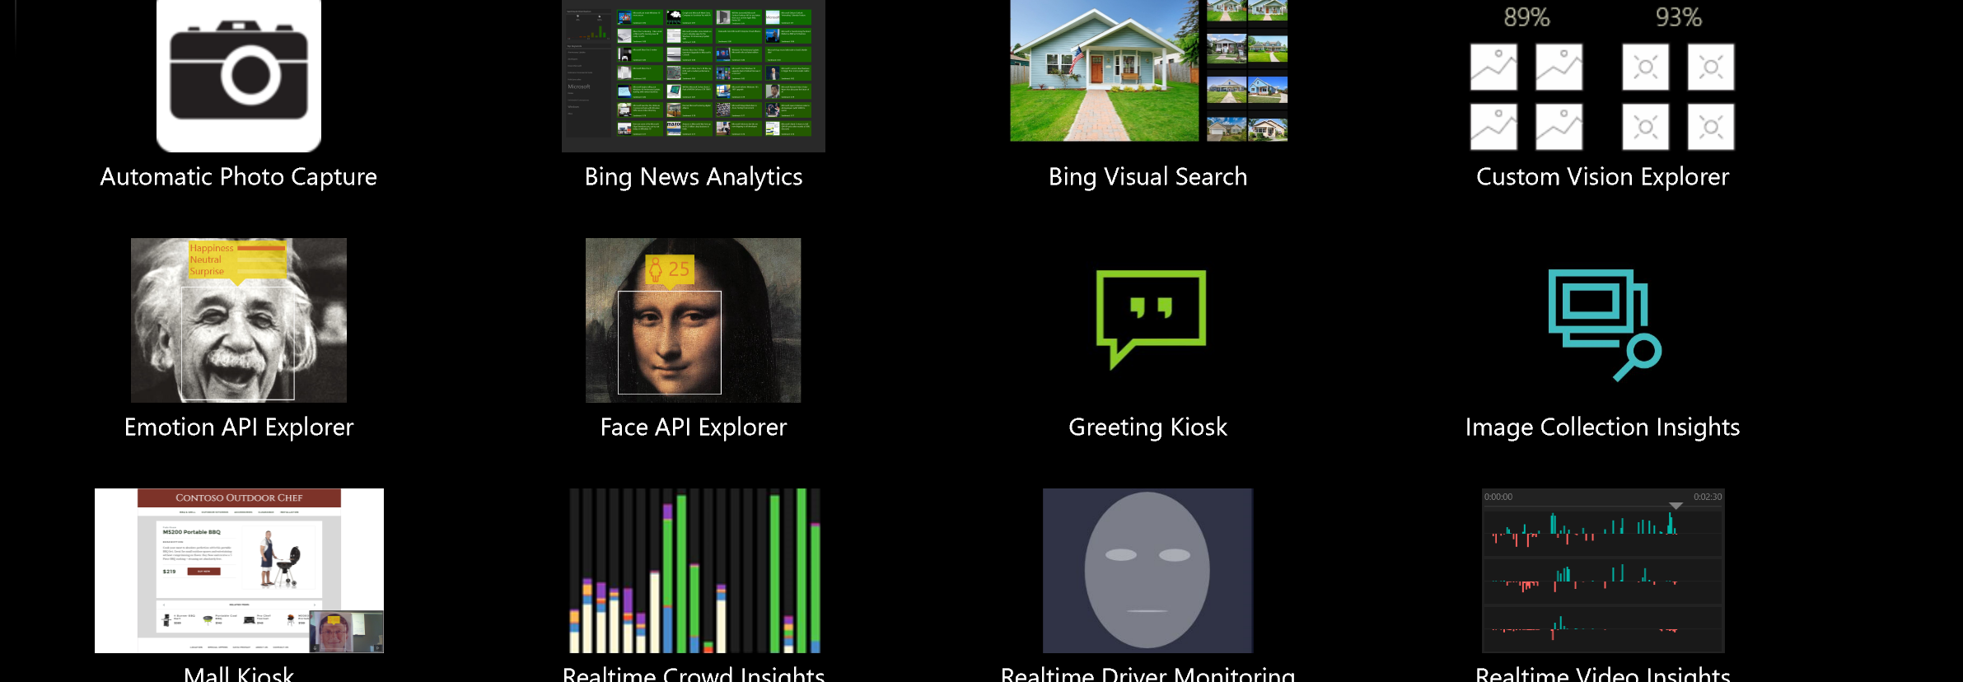
Cognitive Services Kiosk
https://blogs.technet.microsoft.com/msuspartner/2016/10/31/data-analytics-intelligent-kiosk-demo/

Slide 17
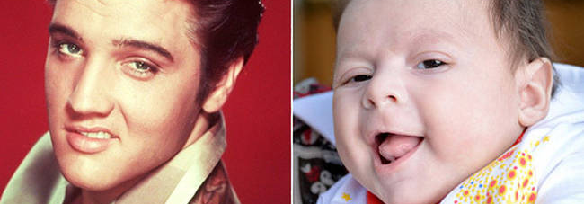
Celebrity Look alike – Bing Visual Search
Take a picture of someone and determine what celebrities they look like.

Slide 18

Is it Trending? News Analytics
Look at recent news articles on a topic, extract keywords & perform sentiment analysis.

Slide 19

Sleepy Driver – Driver monitoring
Tell when a driver is not paying attention and alert them

Slide 20
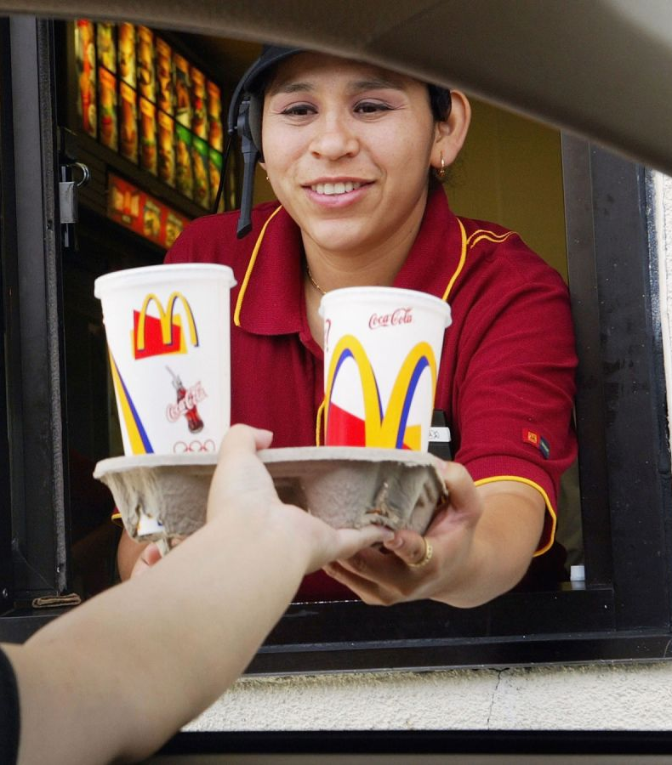
Customer interaction - Crowd Insights
What if you could monitor the facial expressions of your staff to ensure that they were providing “service with a smile”

Slide 21
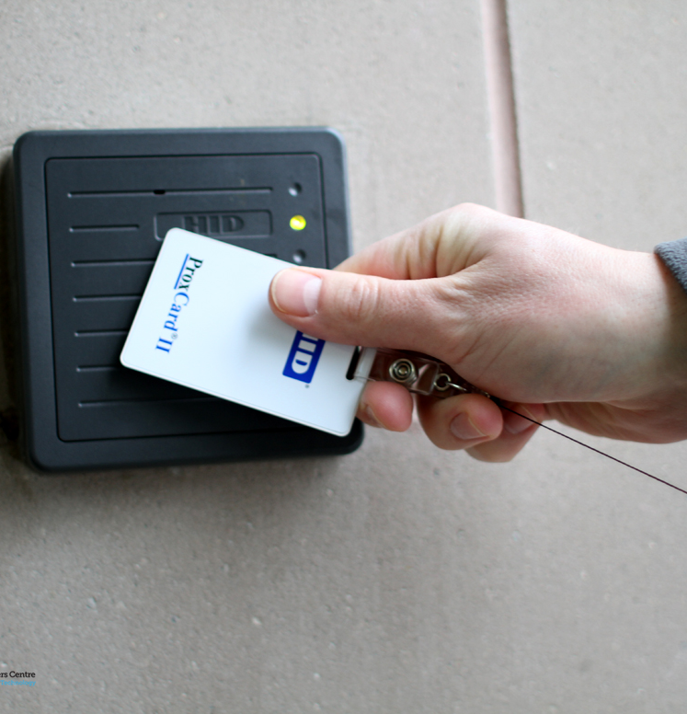
Identify yourself – Greeting Kiosk
Do you require employees to swipe badges when they enter the building? But how do you know that they are using their own badges?

Slide 22

OCR – Vision API
What if you could extract the text from a picture?

Slide 23
How are you going to use them?

Slide 24
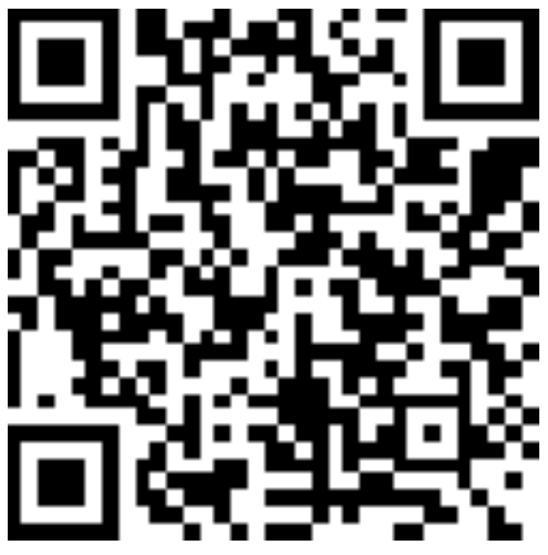
Thank you! Your Feedback is Important
Rate My Talk & Download Slides!
http://bit.ly/RateShawnsTalk
(case sensitive)
Contact Information
Email: sweisfel@microsoft.com
Blog: http://www.shawnweisfeld.com
Twitter: @shawnweisfeld

